Slide 1
Insights for Clinical Center for Dementia
Upul Senanayake

Slide 2
Insights
A Machine Learning model can diagnose a patient with Normal cognition, MCI or Dementia with 96% accuracy.
A large portion of data that is collected do not contribute to the automated diagnosis of the patients although they have value as supporting data.
The Center may be able to reduce the number of tests conducted if ultimate objective is automated diagnosis of Dementia/MCI as this will translate into significant operational cost savings; both for the Center as well as the Patient.
Notes:
The listed accuracy is the balanced accuracy which is the mean of recall. This is for a train/test split. The 5-fold cross validation accuracy is 87.1% without any optimization.

Slide 3
Research Questions
Can the diagnosis of Dementia/MCI be reliably automated?
Can the number of neuropsychological tests conducted be reduced without compromising the accuracy of automated diagnosis?
Are there obvious data quality issues?

Slide 4
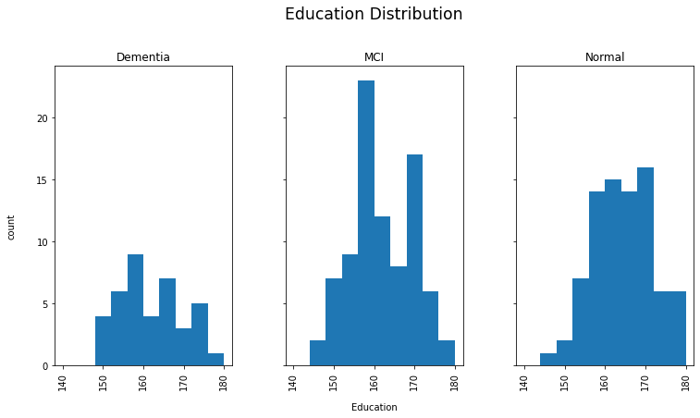
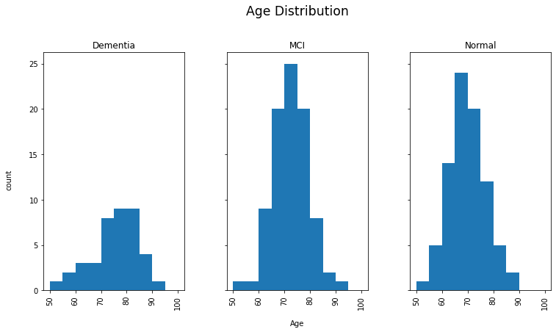
Exploratory Data Analysis
There are no discerning patterns of Age, Education or Gender capable of diagnosing a patient.
There were missing values in some neuropsychological tests; these missing values have been replaced by the respective mean value of that test.
There were no indication of outliers in this dataset.
There appears to be obvious data quality issues with ‘Weight’ measure which has a range of 0 – 20 with a mean of 10.44 (kg or lb). These values are not congruent with the mean and range of an average adult.

Slide 5
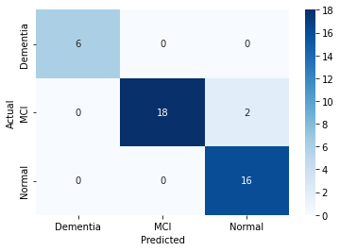
Predictive Modelling
Two machine learning models were trained, a random forest model and a support vector machine model. Random Forest model was the best performer with an accuracy of 96%.
Trained models were tested on unseen data to evaluate the performance of the models.
A MLOps (Machine Learning Ops) pipeline was setup in Github to enable continuous integration and continuous development.
Any new model gets automatically evaluated against the current best model using the above pipeline.
Notes:
The listed accuracy is the balanced accuracy which is the mean of recall. This is for a train/test split. The 5-fold cross validation accuracy is 87.1% without any optimization.
The balanced accuracy of SVM model was 86.1% after hyperparameter optimization with gridsearch. I wanted to demonstrate the difference between a baseline model without optimization (RF model) and an optimized model. In this case, baseline model is still better and should become even better if optimized. Also note that other than balanced accuracy, specificity and precision along with confusion matrix was observed. A detailed analysis of wrongly predicted instances by the RF model is also included in the Jupyter Notebook.

Slide 6
Conclusions and Next Steps
Validating the research questions to determine the objective of Clinical Center for Dementia is integral.
A detailed analysis of failure cases for the current best model can be provided for review.
A recommendation on which neuropsychological tests are highly correlated with each other and hence can be removed without compromising the performance can also be provided.
An analysis on Data Quality issues can also be provided.
Notes:
The quoted analysis in this slide is available in the Jupyter Notebook.

